Slide 1
Common Language Infrastructure (CLI)
Introduction and
Class Library Factorization
Hewlett-Packard
Intel
Microsoft

Slide 2
Outline
What is the CLI?
Factoring the Base Class Libraries
Categories
Packages by Category
Questions and Answers

Slide 3
Overview of the CLI
A file format
A common type system
An extensible metadata system
An intermediate language
Access to the underlying platform
A factored base class library

Slide 4
File Format
Based on COFF
Uses existing extension mechanism
Code represented as MSIL instructions
Metadata stored in read-only area
EAT / IAT for access to platform only
Methods include a descriptive header
  Stack frame size
  Types of local variables and parameters
  Pinned variable information
  Exception handler table

Slide 5
Common Type System
Spans large number of languages
Object-oriented in flavor
Supports procedural and functional languages, too
Includes value types (“structs”), pointers, and by-reference values
Subset for wide reach
  Common Language Specification (CLS)

Slide 6
Metadata System
Self-description for assemblies (components)
  Includes referenced assemblies
  Allows crypto-strong names
  Records version information
  Security boundary
Self-description for types
  Name and defining assembly
  Member information (fields, methods, etc.)
Extensible through custom attributes
Stored in file along with code

Slide 7
Intermediate Language
Simple stack machine model
Typeless opcodes (add, not add.int32)
  Signed and unsigned via opcode, not type
  Rich set of conversion operations
Verifiable subset
Tail calls, virtual dispatch, call via function pointer, exception handling (two-pass)
Typed variable argument lists, dynamically typed pointers
Objects, vectors, and strings are built-in
  As are 32- and 64-bit integers and floats, and 32/64-bit agnostic integers

Slide 8
Access to Platform
Metadata describes managed and unmanaged interface
Marshaling is automatic for many types
Custom marshaling can be specified
Platform-specific transformations are possible (ANSI <-> Unicode, etc.)
Platform-specific calling conventions can be specified

Slide 9
Factored Class Library
Designed for cross-language use
  Adheres to the CLS rules
Factored to allow minimal footprint and minimal hardware requirements
Intended to be platform-neutral
Three layers: kernel, basic language, additional functionality
Methodology and details follow….

Slide 10
Outline
What is the CLI?
Factoring the Base Class Libraries
Categories
Packages by Category
Questions and Answers

Slide 11
Goals
Factored Class Library
  Size constraints (RAM, ROM, Flash)
  Computational constraints (FPU, 64bit support)
  Feature requirements
Factored Execution Environment
  Minimal base is always present
  File format independent of factorization
  Library factorization is the driver
Standardization allows …
  … vendors to specify what’s available
  … developers to specify requirements

Slide 12
Methodology
Define Kernel
  Fixes file format
  Minimal functionality and hardware
  Hand-picked classes and methods
Define Basic Language
  Minimal hardware support required
  Most common language features
    Features required for C# with minimal hardware support
  Depends on classes defined in Kernel
Package each advanced function separately
  Implemented a la cart by runtime vendors
  Required a la cart by developers

Slide 13
Defining a Package
Choose the classes
  A class can only be in one package
  Minimize and specify dependencies on packages
  Base class in package or one it depends on
Basic Language depends on the Kernel package
All other packages depend on both Kernel and Basic Language
Compute the missing methods
  Check it makes sense, new dependencies
  Interfaces may be in another package
    Methods will exist, just can’t cast to interface

Slide 14
Languages and Packages
C#
  Requires Kernel, Basic Language, and Extended Numerics
ECMAScript
  Requires above plus Reflection
ISO C++
  Requires Kernel, Basic Language, Extended Numerics, and NonCLS

Slide 15
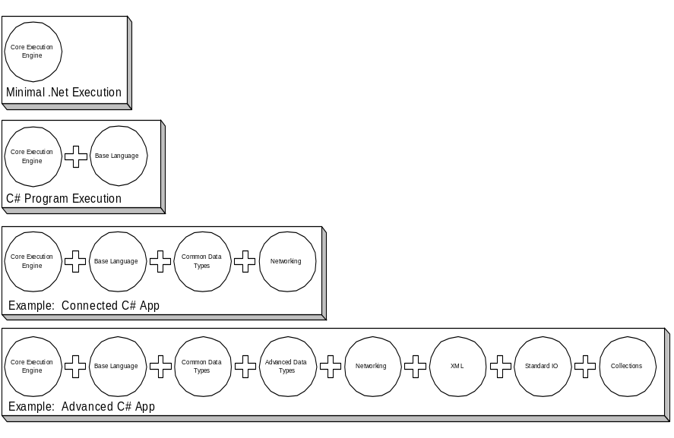
Scenario-based System Design
Scenario | Required Packages
Minimal | Kernel
C# Program | Kernel, Basic Language
Ex: Connected C# Application | Kernel, Basic Language, Common DT, Networking
Ex: Connected XML C# Application | Kernel, Basic Language, Common DT, Advanced DT, Networking, XML, IO, Collections

Slide 16
Outline
What is the CLI?
Factoring the Base Class Libraries
Categories
Packages by Category
Questions and Answers

Slide 17
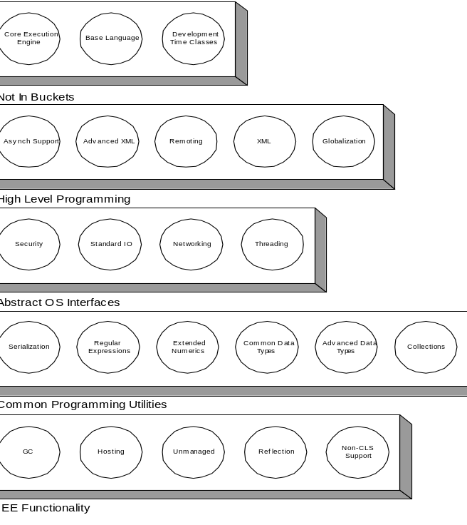
Categories of Packages
Classes grouped into packages
Packages grouped into five categories
  For ease of discussion only
Miscellaneous
High Level Programming
Abstract OS Interfaces
Common Programming Utilities
EE Functionality

Slide 18
The Five Categories (1 – 3)
Abstract OS Interface
  Platform-independent operating system functionality
Common Programming Library
  Classes that support common programming patterns
High-Level Programming
  Programming patterns for the 2000s: XML, remote objects, asynchronous computing

Slide 19
The Five Categories (4 – 5)
EE Functionality
  Revealing underlying operations to programming languages
Miscellaneous
  Kernel, Basic Language, and support for developers

Slide 20
Outline
What is the CLI?
Factoring the Base Class Libraries
Categories
Packages by Category
Questions and Answers

Slide 21
Abstract OS Interface
183 Classes and interfaces
Networking (60)
  System.Net.*
Security (60)
  System.IsolatedStorage, System.Security, …
Standard I/O (32)
  System.Console, System.IO, System.Text, …
Threading (31)
  System.Threading, …

Slide 22
Common Programming Lib.
118 Classes and interfaces
Common Data Types (5)
  System.DateTime, System.Text.StringBuilder, etc.
Advanced Data Types (11)
  System.BitConverter, System.URI, …
Collections (27)
  System.Collections
Extended Numerics (6)
  System.Decimal, System.Double, etc.
Regular Expressions (8)
  System.Text.RegularExpressions.*
Serialization (61)
  System.Runtime.Serialization.*, etc.

Slide 23
High-Level Programming
188 Classes and interfaces
Asynchronous Programming (2)
  System.AsyncCallback, System.IAsyncResult
Globalization (39)
  System.Globalization.*, System.Resources.*, etc.
Remoting (88)
  System.Runtime.Remoting.*
XML (54)
  System.Xml.* (parsing and generation)
Advanced XML (5)
  System.Xml.Xsl.*, System.Xml.XPath.*

Slide 24
EE Functionality
96 Classes and interfaces
GC (2)
  System.WeakReference, System.WeakReferenceException
Hosting (3)
  System.OperatingSystem, etc.
NonCLS (3)
  System.ArgIterator, etc.
Reflection (62)
  System.Reflection.*, etc.
Unmanaged (26)
  System.Runtime.InteropServices, etc.

Slide 25
Miscellaneous
107 Classes and interfaces
Kernel (66)
  1, 2, and 4 byte integers, arrays, string, object, etc.
Basic Language Support (17)
  System.EventHandler, System.IFormattable, System.Type, etc.
Development Time (24)
  System.Diagnostics.*, System.Runtime.CompilerServices.*

Slide 26
Outline
What is the CLI?
Factoring the Base Class Libraries
Categories
Packages by Category
Questions and Answers

